Slide 1
Bucket Sort

Slide 2
Time complexity of Sorting
Several sorting algorithms have been discussed and the best ones, so far:
  Heap sort and Merge sort: O( n log n )
  Quick sort (best one in practice): O( n log n ) on average, O( n² ) worst case
Can we do better than O( n log n )?
  No.
  It can be proven that any comparison-based sorting algorithm will need to carry out at least O( n log n ) operations

Slide 3
Restrictions on the problem
Suppose the values in the list to be sorted can repeat but the values have a limit (e.g., values are digits from 0 to 9)
Sorting, in this case, appears easier
Is it possible to come up with an algorithm better than O( n log n )?
  Yes
  Strategy will not involve comparisons

Slide 4
Bucket sort
Idea: suppose the values are in the range 0..m-1; start with m empty buckets numbered 0 to m-1, scan the list and place element s[i] in bucket s[i], and then output the buckets in order
Will need an array of buckets, and the values in the list to be sorted will be the indexes to the buckets
  No comparisons will be necessary

Slide 5
Example
4 | 2 | 1 | 2 | 0 | 3 | 2 | 1 | 4 | 0 | 2 | 3 | 0
0 00
1 1
2
2 22
3 3
4 4
0 | 0 | 0 | 1 | 1 | 2 | 2 | 2 | 2 | 3 | 3 | 4 | 4

Slide 6
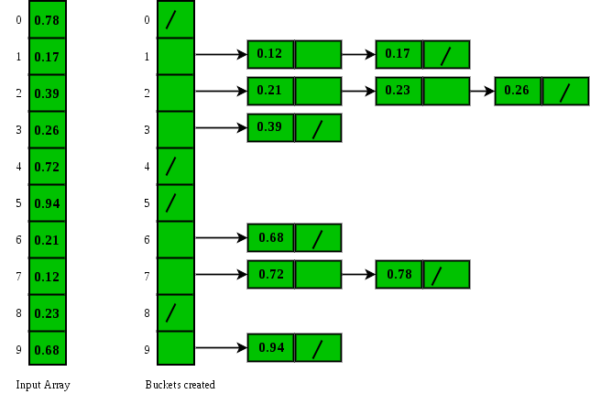
Bucket Sort

Slide 7
Bucket sort algorithm
Algorithm BucketSort( S )
( values in S are between 0 and m-1 )
for j ← 0 to m-1 do // initialize m buckets
b[j] ← 0
for i ← 0 to n-1 do // place elements in their
b[S[i]] ← b[S[i]] + 1 // appropriate buckets
i ← 0
for j ← 0 to m-1 do // place elements in buckets
for r ← 1 to b[j] do // back in S
S[i] ← j
i ← i + 1

Slide 8
Values versus entries
If we were sorting values, each bucket is just a counter that we increment whenever a value matching the bucket’s number is encountered
If we were sorting entries according to keys, then each bucket is a queue
  Entries are enqueued into a matching bucket
  Entries will be dequeued back into the array after the scan

Slide 9
Bucket sort algorithm
Algorithm BucketSort( S )
( S is an array of entries whose keys are between 0..m-1 )
for j ← 0 to m-1 do // initialize m buckets
initialize queue b[j]
for i ← 0 to n-1 do // place in buckets
b[S[i].getKey()].enqueue( S[i] );
i ← 0
for j ← 0 to m-1 do // place elements in
while not b[j].isEmpty() do // buckets back in S
S[i] ← b[j].dequeue()
i ← i + 1

Slide 10
Time complexity
Bucket initialization: O( m )
From array to buckets: O( n )
From buckets to array: O( n )
  Even though this stage is a nested loop, notice that all we do is dequeue from each bucket until they are all empty –> n dequeue operations in all
Since m will likely be small compared to n, Bucket sort is O( n )
  Strictly speaking, time complexity is O ( n + m )

Slide 11
Sorting integers
Can we perform bucket sort on any array of (non-negative) integers?
  Yes, but note that the number of buckets will depend on the maximum integer value
If you are sorting 1000 integers and the maximum value is 999999, you will need 1 million buckets!
  Time complexity is not really O( n ) because m is much > than n. Actual time complexity is O( m )

